Slide 1
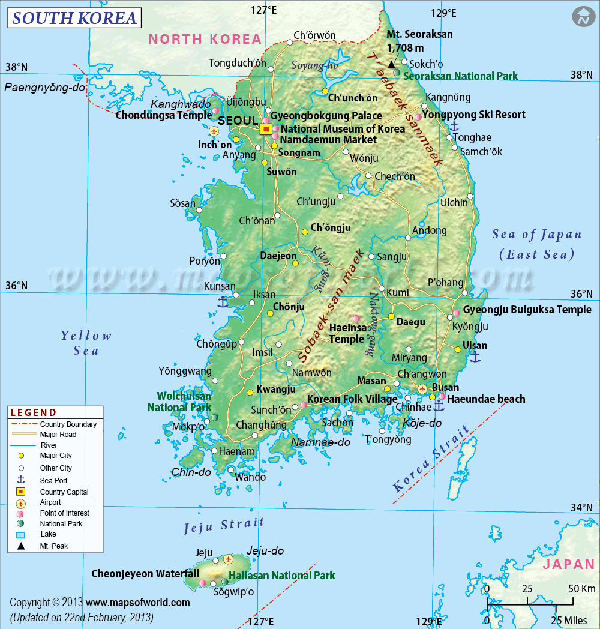
South Korea
by: Conrad Briones , Conner Hatch , Rodrigo Dominguez, Connor Eyre, Joe Benson, Brielle Stauffer, Yehyun Kim, Steven Call

Slide 2
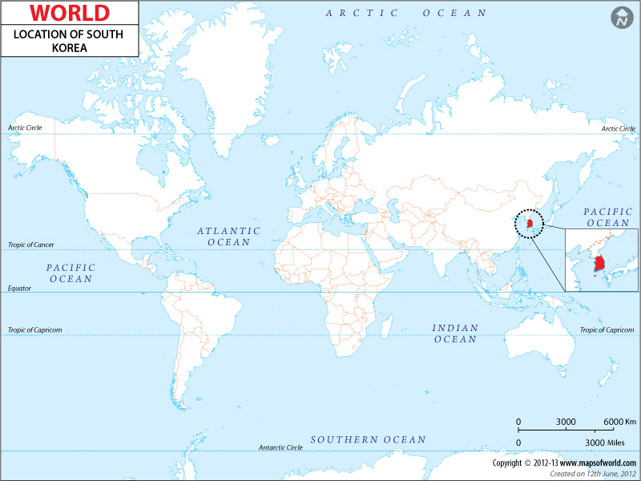
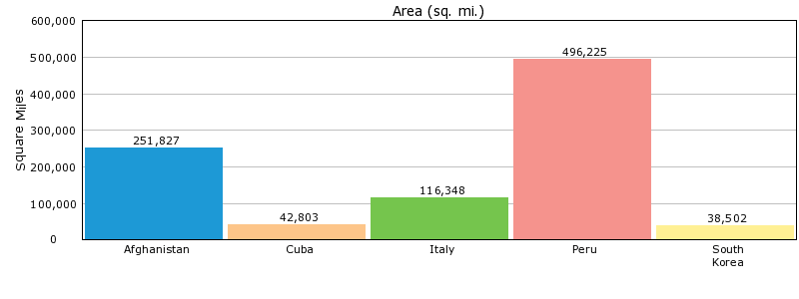
the location of south korea on the world map
comparison of neighboring countries

Slide 3
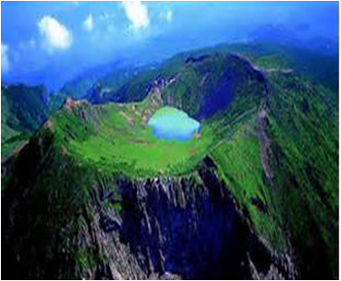
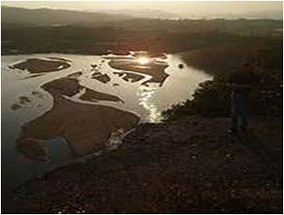
South Korea has no plains
NakDong is South Korea’s longest river. (521 kilometers)
70% of South Korea is mountains.
Hallasan in the biggest mountain in south Korea.

Slide 4
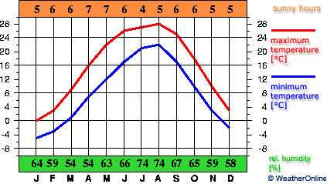
Weather in South Korea
January: The weather is really cold and wind blows in January.
July: The weather is hot and wet.
Korea has 4 distinct seasons.

Slide 5
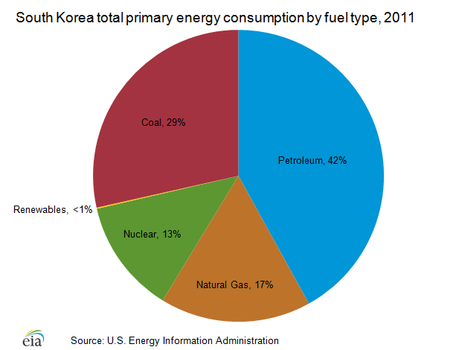
Natural resources
coal, tungsten, graphite, molybdenum, lead, hydropower potential.

Slide 6
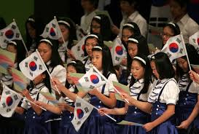
South Korean Independence Day
Japan took over the country in 1905. But in August 13th 1948 South Korea got their independence from Japan.

Slide 7
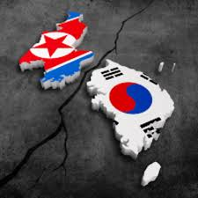
War to separate North and South
Post Second World War, the division of Korea and the following Korean War shaped the early politics of the Republic of Korea. The three-year war had engaged all the major powers who came closer thus inciting a nuclear conflagration. In the following three decades, the two Koreas were locked into opposing Cold War blocs, and went their own separate ways.

Slide 8
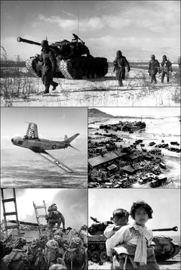
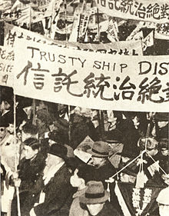
Korean war
The Korean War (25 June 1950 – 27 July 1953) was a war between the Republic of Korea (South Korea), supported by the United Nations, and the Democratic People's Republic of Korea (North Korea).

Slide 9
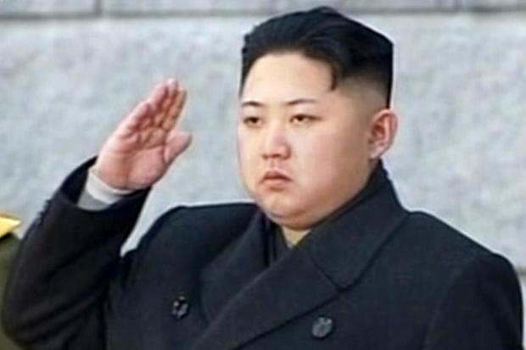
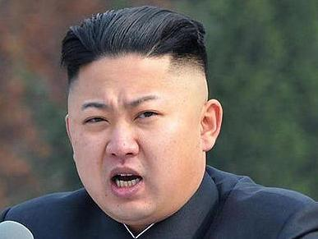
South Korea news
from the south Korea news page
A little more than a month ago, news leaked from North Korea on how the former girlfriend of supreme leader Kim Jong-un had been "gunned down" after being arrested on pornography charges.
RELATED: Kim Jong-un's former girlfriend shot by firing squad
North Korea has repeatedly defied international pressure to halt its nuclear weapons program, with fears that it now has enough weapons-grade plutonium to make up to 10 warheads.
The United States, which has almost 30,000 troops stationed in South Korea, says the presence of the USS George Washington carrier battle group was part of a "routine" port call.

Slide 10
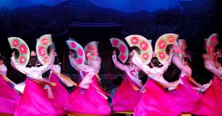
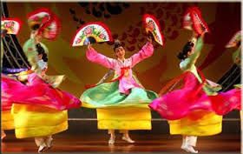
In south Korea they celebrate a holiday almost every month!February
Inje Ice Fishing Festival (tel. 033/460-2082) occurs every winter, when Soyang lake freezes over and hundreds of people flock to this mountain village in the inner Seoraksan area. Not only will you be able to ice fish, but you also can play ice soccer, go sledding, watch a dog sled competition, and enjoy a meal of freshly caught smelt. Late January through mid-February.
March
Jeongwol Daeboreum Fire Festival celebrates the first full moon of the lunar year. The celebrations involve both livestock -- there are duck and pig races -- and nods to the island's history. The festival arose from the island's ancient practice of burning grazing fields, which served the dual purpose of razing the land for new crops of grass and getting rid of pests. Don't miss the spectacular fireworks show. February or March on the 15th day of the first lunar month.
May
Boseong Green Tea (Da Hyang) Festival (tel. 061/852-1330; www.boseong.go.kr) is held in South Korea's most important tea-producing region. This is a great way to enjoy Jeollanam-do (Jeollanam province) and to taste some of the finest nokcha (green tea) in the world. You can also try foods made with green tea, try a tea facial, and participate in traditional tea ceremonies. Early May, in odd-numbered years (2011, 2013, and so on).
Read more: http://www.frommers.com/destinations/south-korea/618706#ixzz2iTZv13MH

Slide 11
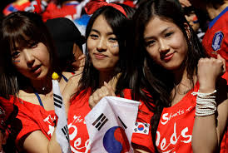
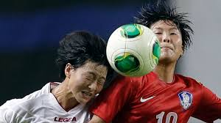
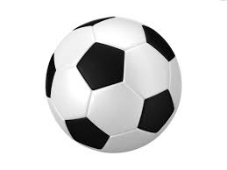
soccer in south Korea!
People in south Korea, love to play soccer, like here in the us, football is big, well there soccer is huge!

Slide 12
South korea form of government
The Government of South korea is divided executive judicial branches. The executive and judicial branches operate primarily at the national level, although various ministries in the executive branch also carry out local functions. Local government are semi-autonomous, and contain executive and legislative bodies of their own.

Slide 13
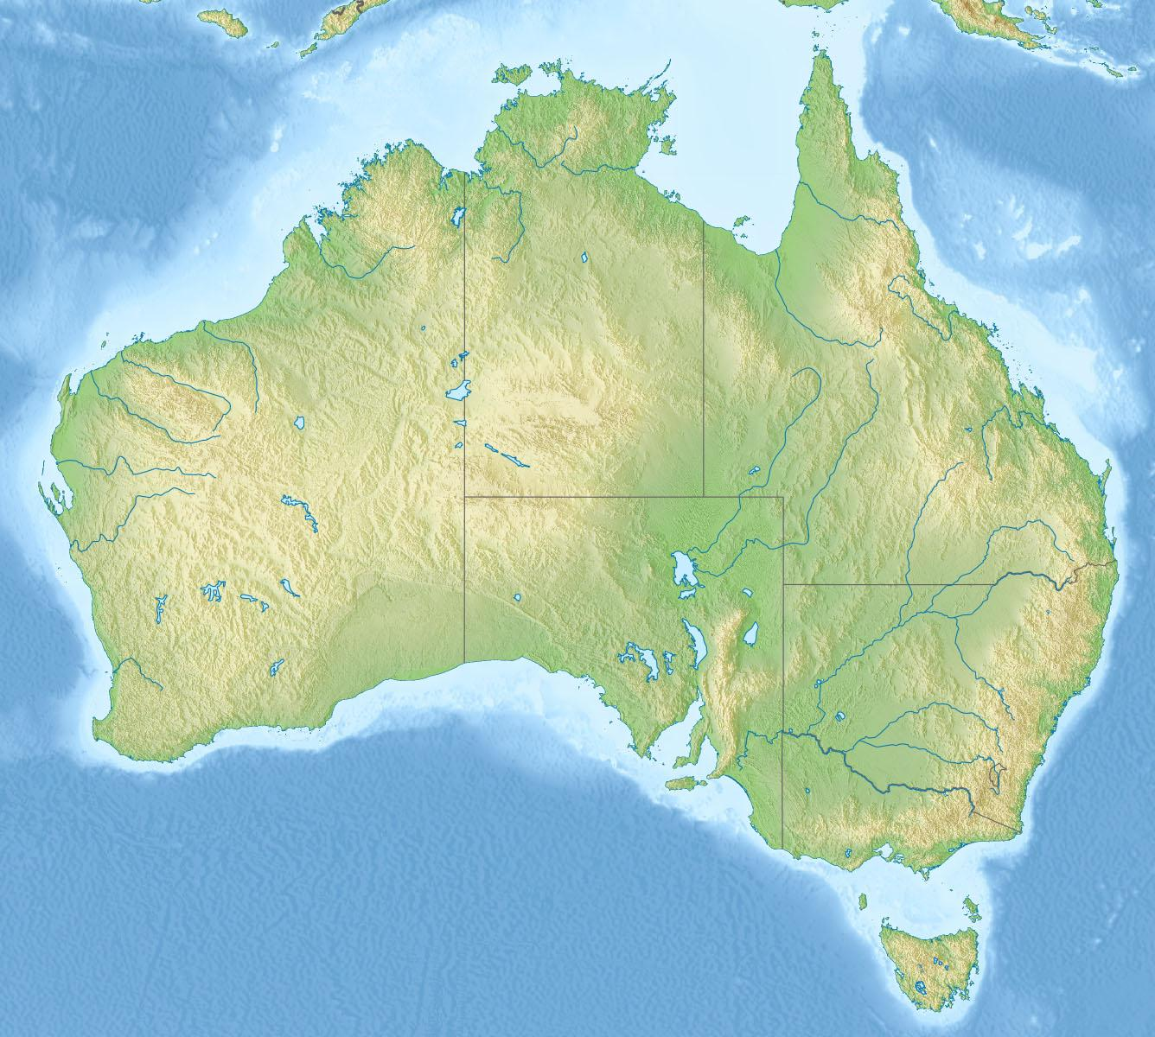
korean Allies and Enemies
Allies: Australia and the United States
Enemies:Cuba
Macedonia
North Korea
North Cyprus
Palestine
Republic of China
Sahrawi Arab Democratic Republic
Syria

Slide 14
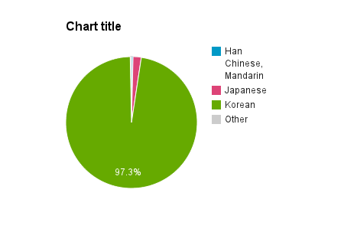
Pie chart (race)
*97.3% are korean
*.4% are Han Chinese,
Mandarin
*2% are japanese

Slide 15
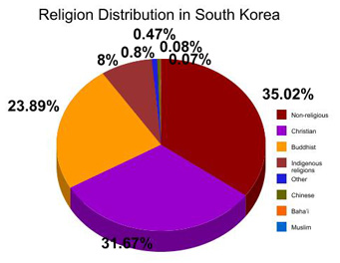
The religions in south Korea

Slide 16
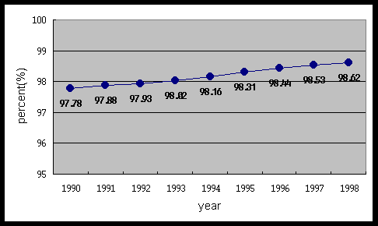
The Literacy Rates in South Korea

Slide 17
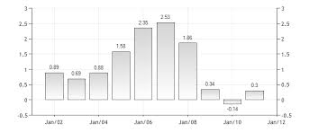
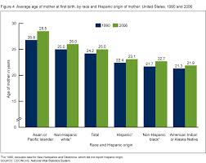
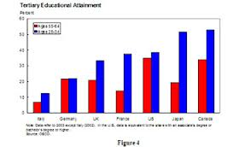
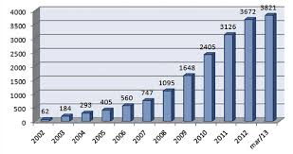
population of these countries!
Iceland, South Korea, Italy and Brazil

Slide 18


Slide 19
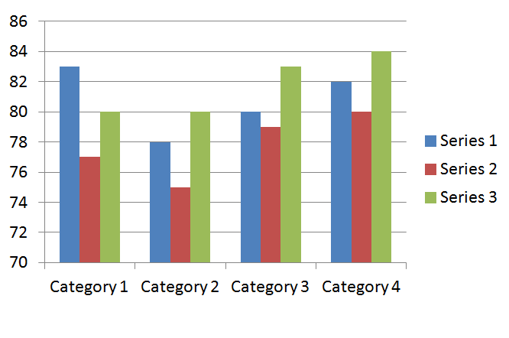
Blue is women life expectancy; red is men; green is average

Slide 20
