Slide 1
Japan
By John Adams, Denise Mauricio, Rebecca Hickman, Ryan Glover, Dallin Keele, Ben Lawrence, Isaak Thoreson, Sofia Arzola - A4 10/2/13

Slide 2
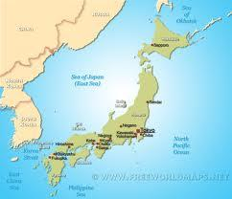
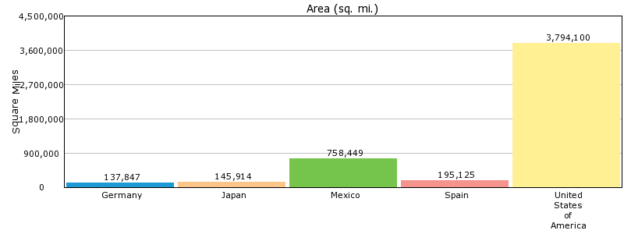
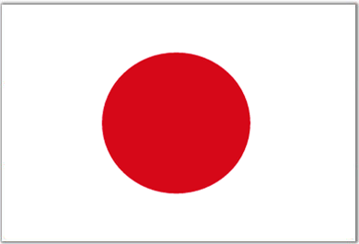
Location And Sizes
- Japan Is around 1/20 of the size of America, this is a little smaller than California!
- Japan is located next to China, right below Russia.
- The current Population Of Japan is estimated at about 126.66 million people. Thats around 873.1 people per square mile!

Slide 3
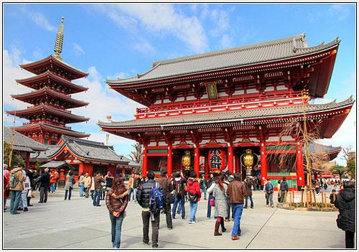
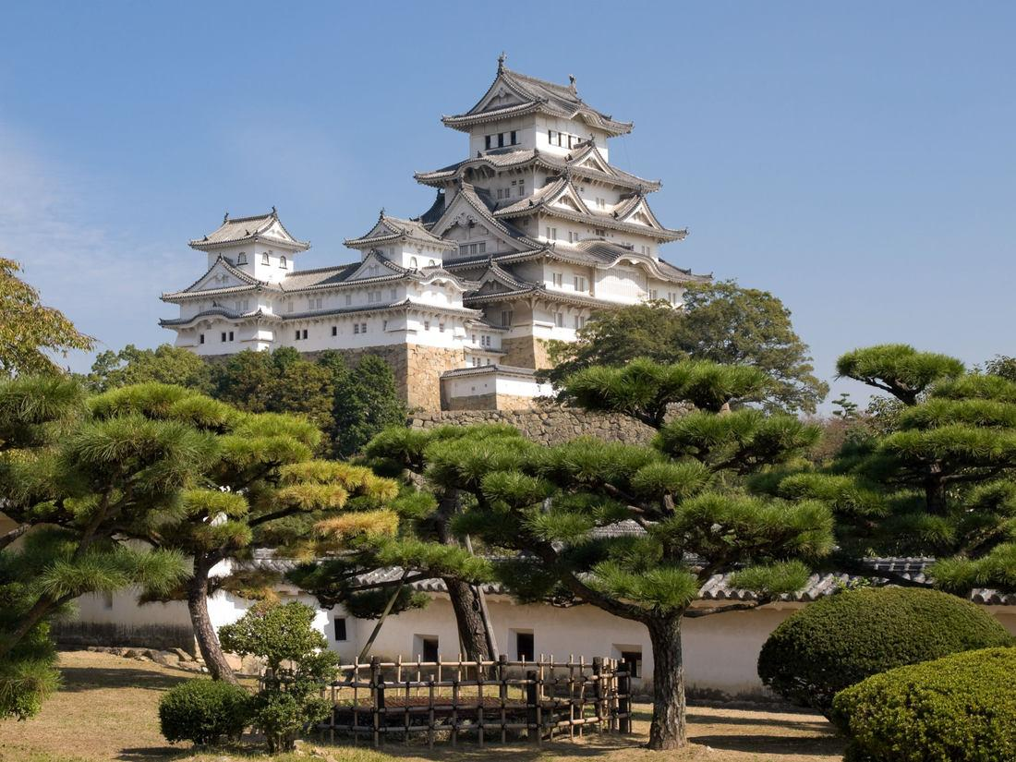
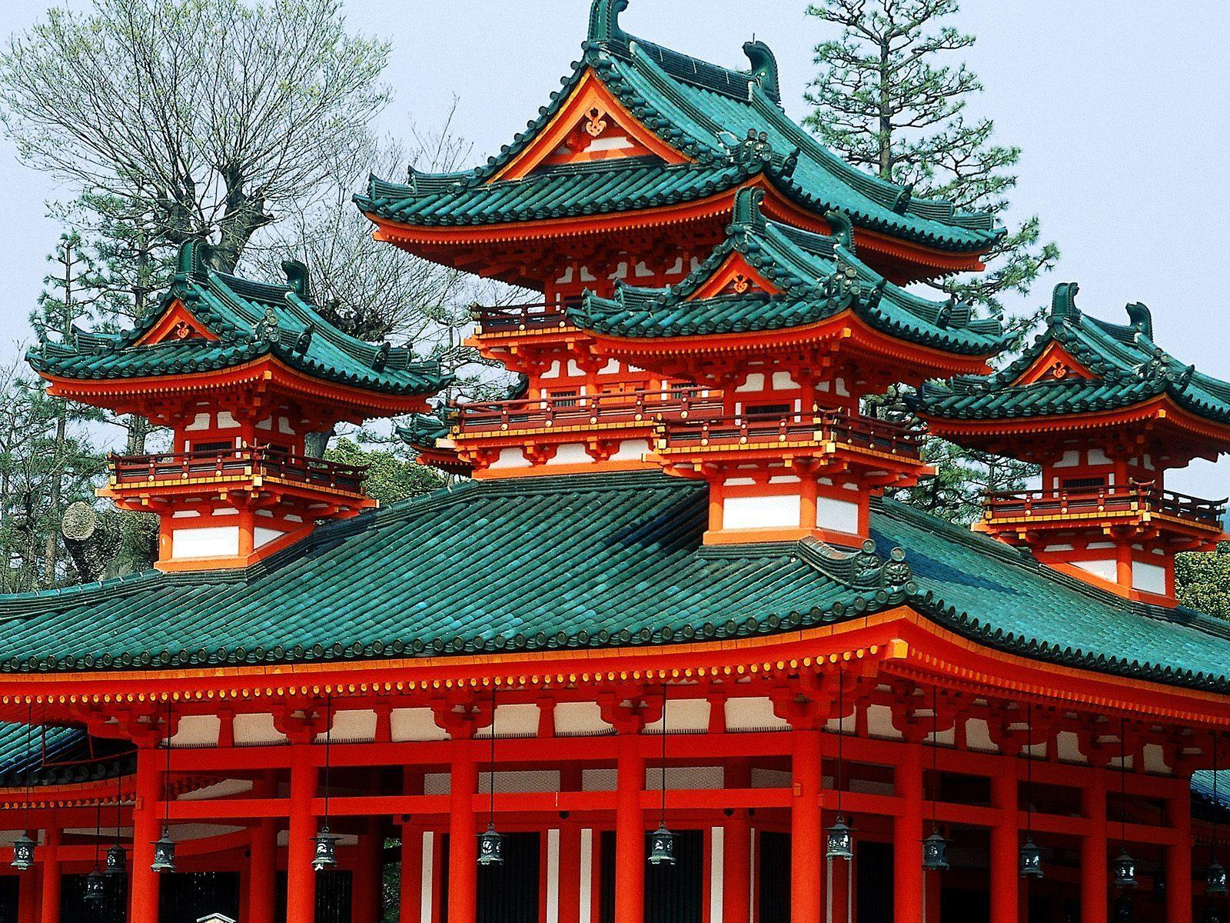
Interesting Aspects Of Topography
Japan Has Many Interesting Places
Japan Has many Beautiful and interesting places!
including…
- The Hiroshima Peace Memorial
- Kiyomizu-dera
- Himeji Castle
- Todaiji Temple
- & Tokyo Tower!

Slide 4
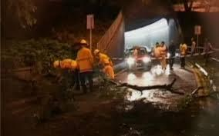
Weather Extremes
Japan being a large island often experiences floods, strong storms or hurricanes, and even tsunamis on rare occasions

Slide 5
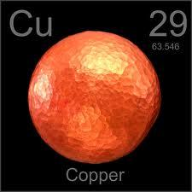
Natural Resources
Japan’s natural resources include, but are not limited to, copper, iron ore, lead and zinc.

Slide 6
The country's formation
Around 12,000 BC, Japan’s rich ecosystem was home to human development. Most of Japan’s culture came from Chinese influence.

Slide 7
Early military and war
Japan’s early military history can be traced back to 10,000 bc. There are four main sections that can be separated into smaller sections. The four main sections are Prehistory, Ancient and Classic, Feudal and Modern Japan.

Slide 8
Early inhabitants
The Ainu people are the indigenous people of Japan. Many Ainu live in the same place, and although exact numbers aren’t know, it’s an estimated

Slide 9
Sept. 20th, 2013
Japanese Prime Minister, Shinzo Abe, ordered Tokyo Electric Power Company to decommission all six of the Fukushima plant’s nuclear reactors. These six reactors survived the tsunami and earthquake that struck Friday, 11 March 2011 and damaged the other four reactors.

Slide 10
Oct. 02, 2013
Japan and the United STates have both said that Japan will pay $3.1 Billion US dollars to relocate American Marines from Okinawa. That’s 36% of the estimated $8.6 Billion dollars!

Slide 11
Pop Culture
Japanese Pop culture is very diverse. From traditional music, such as Min’yō folk music, to J-Pop with artist such as Southern All Stars and Yellow Magic Orchestra. Japan has been Westernized, but still retains a lot of its rich traditions.

Slide 12
Form of Government
Japan is a parliamentary government with a constitutional monarchy.
Political parties and Leaders:
Democratic Party of Japan or DPJ: Banri Kaieda
Japan Communist Party or JCP: Kazuo Shii
Japan Restoration Party or JRP: Shintaro Ishihara
Liberal Democratic Party or LDP: Shinzo Abe
New Komeito or NK: Natsuo Yamaguchi
People’s Life Party or PF: Ichiro Ozawa
Social Democratic Party or SDP: Mizuho Fukushima
Tomorrow Party of Japan or TPJ : Tomoko Abe
Your Party or YP: Yoshimi Watanabe

Slide 13
Japan’s Allies
Japan currently has three allies, The United States, South Korea and Taiwn. These countries would aid Japan, if needed, should the country ever go to war. They also maintain economic alliances with Australia, and most of Europe.

Slide 14
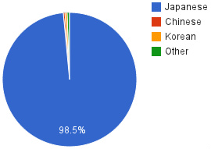
Ethnicity Comparison

Slide 15
Primary Languages
The primary language of Japan is currently Japanese with small hints of Chinese, Korean, and village languages throughout.

Slide 16
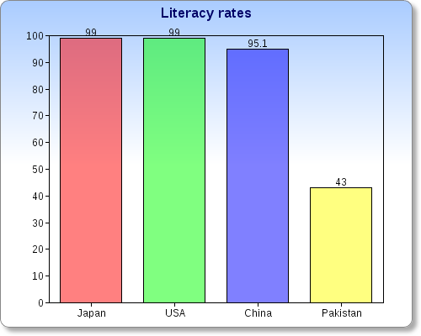
Literacy Rate

Slide 17
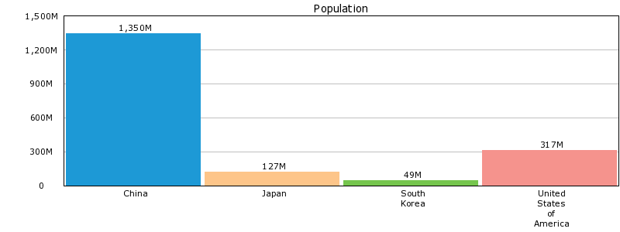
Population Comparison (Japan’s Population compared to other countries.

Slide 18
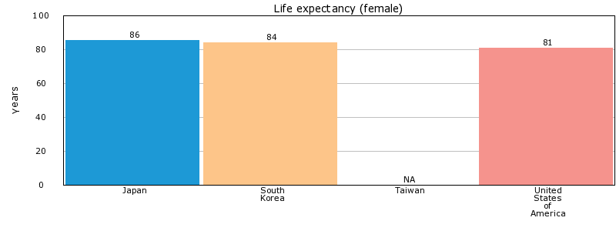
Life Expectancy for Females

Slide 19
Major Imports
Japans major imports are the following:
*Various Foods
*Oils
*Different kinds of Wood
Japans biggest imports are from china followed by the USA.

Slide 20
Economic Base
Japan’s main economy is based off of robotics and technology, which is a fastly growing market there. They also have a large industry in agriculture and automobiles

