Slide 1
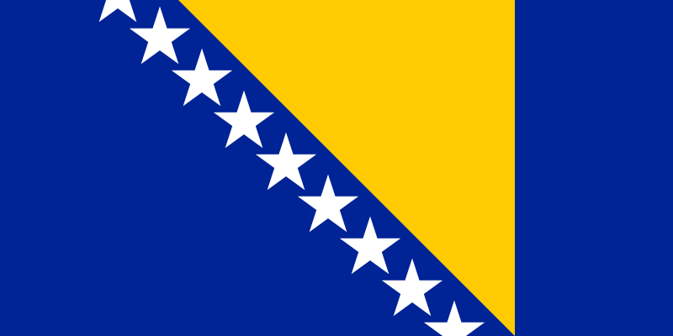
By: Dresden Holden Means, Liam McLean Isaak, Madison Jeremiah Tullis, Natalie Nicole Hatch, Annie Smith, Jordan David Love, Tessa Mae Gappmayer, Nabil Edward Albert,

Slide 2
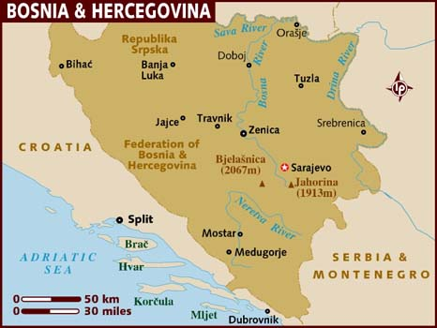
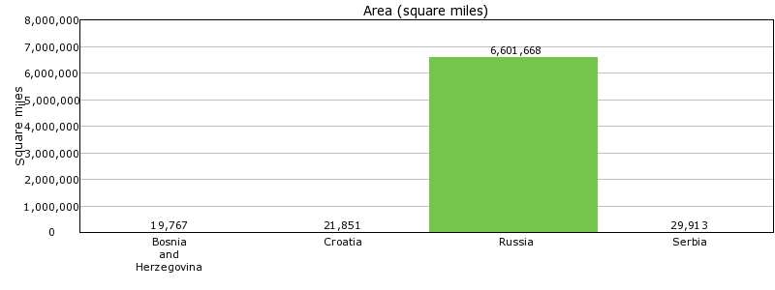

Slide 3
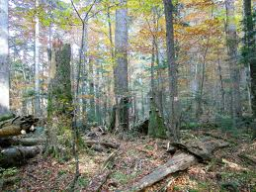
Topography
50% of Bosnia's landscape is forest, and is made of hills mountains and valleys

Slide 4
Weather july & january
In January it is colder and in July is a lot warmer

Slide 5
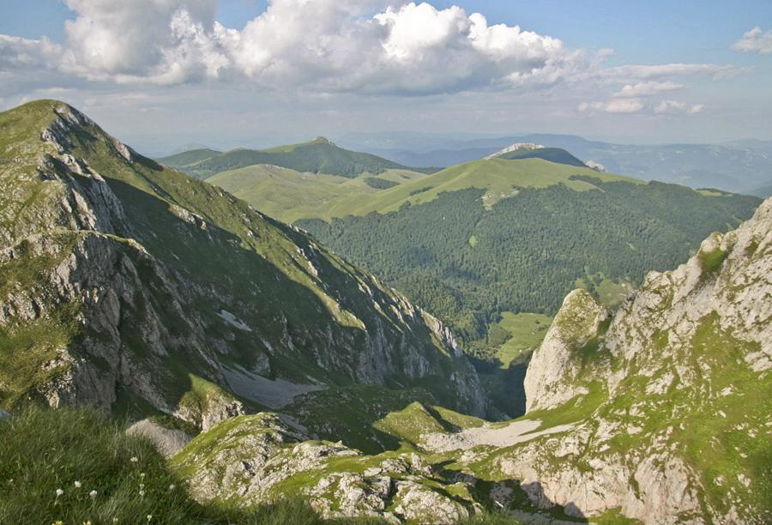
Natural Resources
Natural Resources in Bosnia
The natural Resources are coal, iron ore, bauxite, copper, lead, zinc, chromite, cobalt, manganese, nickel, clay, gypsum, salt, sand, timber, hydropower.

Slide 6
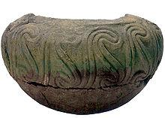
EARLY HISTORICAL HIGHLIGHTS
First populated by Illyrians and Celtics
Conquered by Romans in 9 A.D.
Area re-conquered by Byzantine empire in the sixth century
Ancient bowl found in Bosnia

Slide 7
MIDDLE AGE
HISTORICAL HIGHLIGHTS
Briefly was the kingdom of Bosnia
Conquered by the Ottoman Empire
Unsuccessful revolt in 1831
MEOW!!!!!!!!
Flag of the revolt

Slide 8
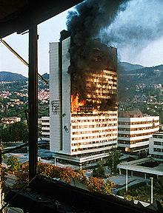
MODERN HISTORICAL HIGHLIGHTS
Conquered by the Nazis in 1941
After World War two, it formed part of Yugoslavia
From 1992 to 1995, the Bosnian War ravaged the country
A building after being hit in a bombing
raid during the Bosnian war

Slide 9
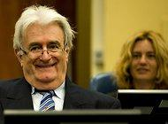
Recent events
Former bosnian leader begins his defense at genocide trial.
Someone accused this bosnian leader of being the architect of a brutal 3 year war.
Notes:
He looks funny

Slide 10
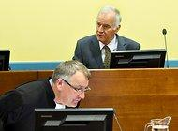
Recent events
Ratko Mladic a former military commander is facing a lot of years if not life in jail. he faces these charges because during the war he shelled (bombed) and sniped civilians. he has been in hiding for 17 year with the help of his friends and is now facing serious jail time.
Ratko Mladic

Slide 11
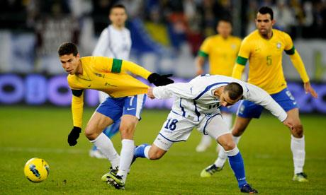
Pop Culture or Bosnia
They listen to music from local artists and from artists in the USA. They basically listen to the same music we do. You would not find any big companies there like McDonalds, Burger King etc. Although they don't have big companies there, they basically have the same entertainment as us. They even play video games just like us. They do more sports and outdoor activities more than us though.

Slide 12
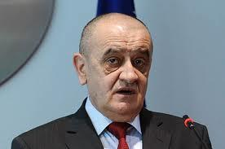
Political System
Form of Government: Parliamentary
Current Government Leader: Vjekoslav Bevanda

Slide 13
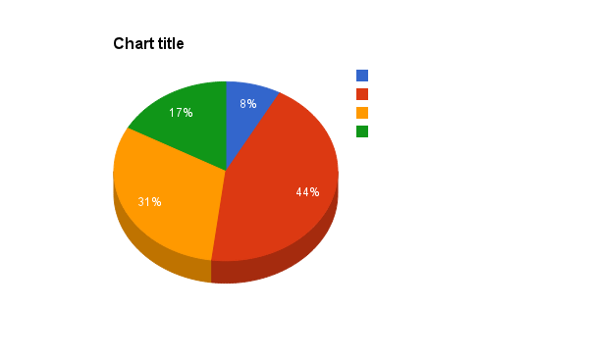
Percent of Race
Other
Muslim
Serb
Croat

Slide 14
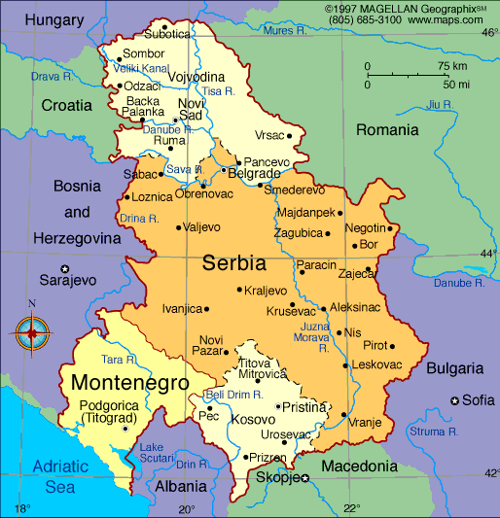
Political system
Enemies: Serbia

Slide 15
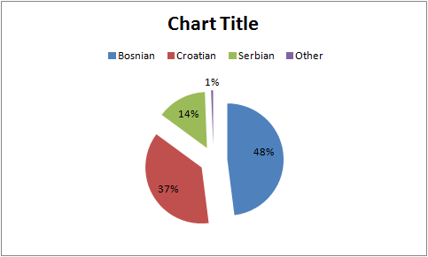
Primary languages

Slide 16
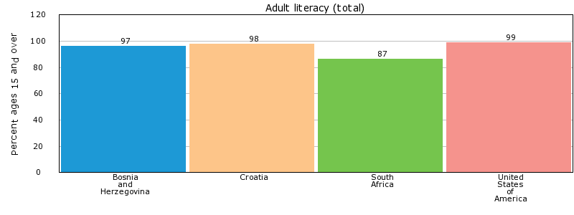
Literacy Rate
The total adult literacy rate for Bosnia and Herzegovina, Croatia, the U.S. and South Africa are:

Slide 17
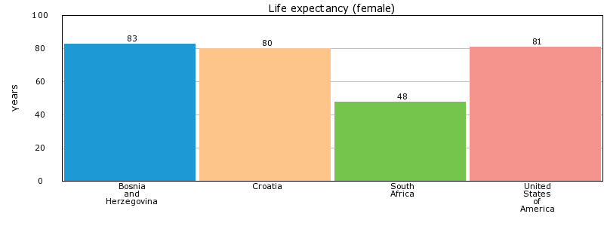
Life expectancy

Slide 18
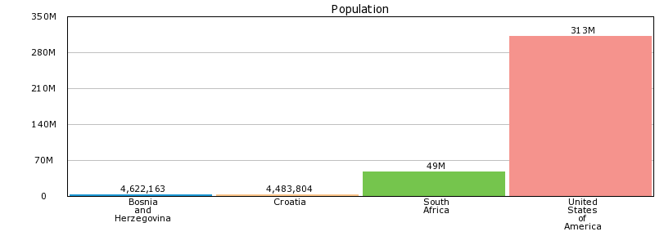
Population

Slide 19
Imports
Some of the imports are food products, beverages, machinery and equipment.

Slide 20
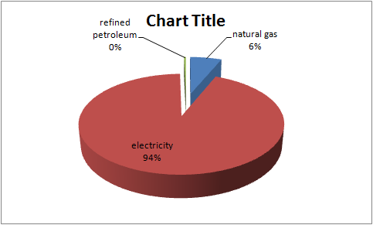
Exports

