Slide 1
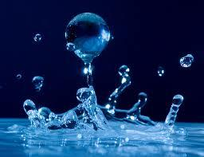
Sustainable Water
November 28 & 29, 2012

Slide 2
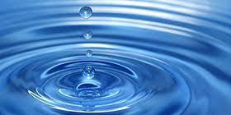
Why Is Water Important?
Life is not possible without water!
Water is in every living thing.
Our body is nearly 65% water.
An ear of corn is nearly 70% water, a potato is about 80%, and a tomato is about 95%.
In order for living things to carry out life processes, we must keep our water supply clean and healthy. We can live without food for two months, but we cannot live without water for more than a week.

Slide 3
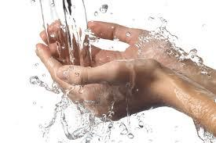
What do we use it for?
Drinking
Agriculture
Washing
Transportation
Recreation
Hydroelectricity
Industrial uses
Food Processing
Scientific/Chemical uses

Slide 4
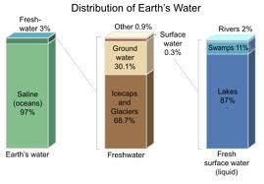
How Much Do We Have?

Slide 5
Let's look at the numbers!
70% of the earth is water
97% is in the oceans
The fresh water available for us to use is about 3% of the earth's water supply.
Three-fourths of the fresh water is unavailable because it is in icecaps and other glaciers.

Slide 6
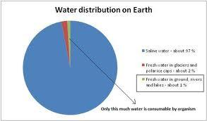

Slide 7
More Numbers...
Americans use more than 400 billion gallons of water in one day, more than our total oil consumption in one year!
Every day 5,000 children die from diseases associated with inadequate water supply, sanitation and hygiene. All of which are preventable

Slide 8
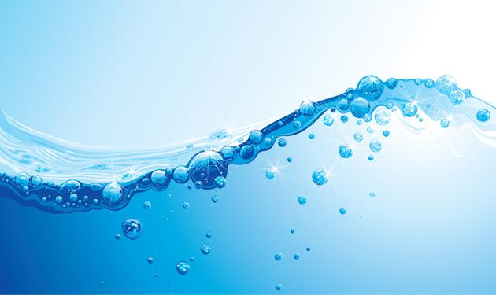
DO WE HAVE ENOUGH?
Yes, we do!
But... We need to use it more wisely!

Slide 9
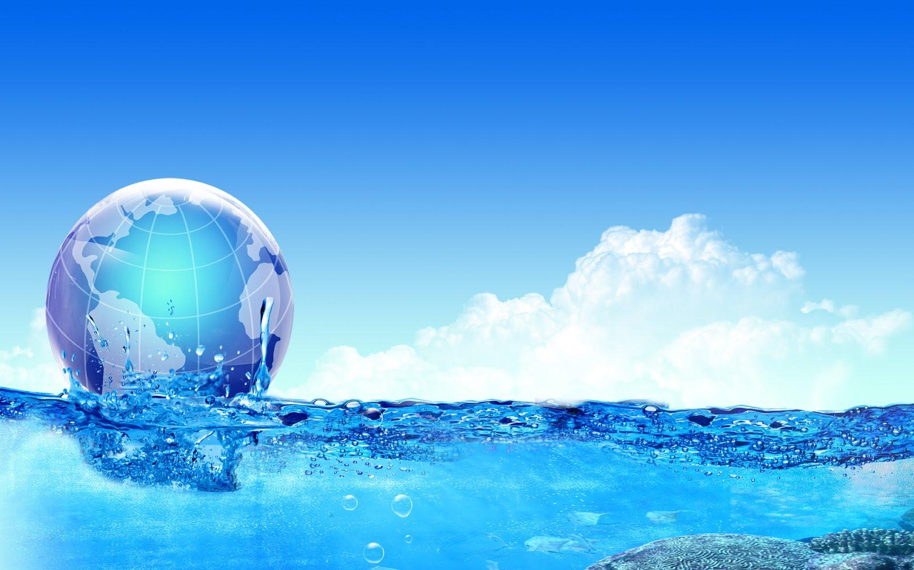
Sustainable Water
Sustainability means providing an adequate and reliable water supply of desired quality – now and for future generations – in a manner that integrates economic growth, environmental protection and social development.

Slide 10
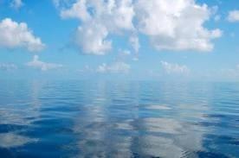
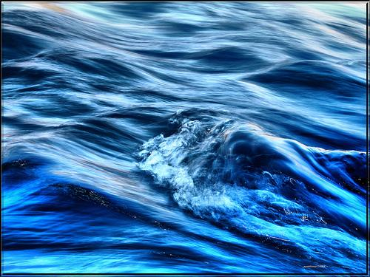
What Can We Do?

Slide 11
Blue Gold: World Water Wars
How are humans affecting the Hydrological System, and contributing to the depletion of fresh water? List 4 things.
What can we do to change what is happening to our fresh water supply?
If this continues, what do you think will happen?

Slide 12
Desalination
PROS:
Creates clean water
Better for the earth than pipelines and dams
CONS:
Energy
Pollution
Money
Location
Hurts marine life

Slide 13
Is pumping and transporting water a good or bad thing?

Slide 14
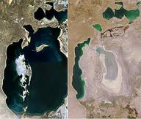
Aral Sea
1989
2008

Slide 15
1. What are humans doing to affect the hydrological system, and how is it affecting the depletion of the freshwater supply? List 4 things.
2. What can we do to change what is happening to our water supply?
3. If we continue to use the water the way we are currently, what do you think will happen?

Slide 16
Research!
Now research water in your MUN country. Write a one-paragraph solution on how your MUN country could solve some of the water problems that exist there.

